Slide 1


Implementing ChatOps using Microsoft Power Platform
Eldert Grootenboer
Notes:
Rustig spreken
Niet te veel tekst bij slides

Slide 2


Eldert Grootenboer
@egrootenboer

Slide 3

ChatOps
Notes:
5
Recap previous section

Slide 4
ChatOps
ChatOps is all about conversation-driven development. While in a chat room, team members type commands that the chatbot is configured to execute through custom scripts and plugins. These can range from code deployments, to security event responses, to team member notifications.
Notes:
https://www.pagerduty.com/blog/what-is-chatops/

Slide 5
What is ChatOps
Conversation driven collaboration
Take actions by interacting
Evolution of DevOps

Slide 6

Why should we use it
Provide simple UI
Easy automation
Visibility

Slide 7
Use cases
Any time, any place, any device
Central logging
Teach by example
Single entry-point for different services
Distributed teams
Notes:
Bi-Directional Capability
The capability to share messages and information between different tools is advantageous to productivity. People are constantly working in and out of a number of applications and tools. So, making communication accessible and actionable across your whole ChatOps toolchain allows more cross-functional collaboration and improves operational agility.
User Tracking and Control
The ability to track communication associated with who is performing what task, from which application, can show the larger picture of an incident’s history. After the fact, this allows teams to create more detailed post-incident reviews and make communication improvements for the future.
Interactive Commands
Interactivity in your ChatOps tools is the next step up from simply communicating. Being able to run scripts, retrieve information when you need it, or acknowledge/resolve incidents directly from chat allows for faster incident detection, acknowledgment, and remediation. Combining real-time communication and incident interactivity in your workflow creates huge ChatOps advantages.

Slide 8

Microsoft Power Platform
Notes:
10

Slide 9

The various services
Notes:
No code, low code
Get started easily
Citizen developers

Slide 10
Empower your organization
No code, low code
Get started easily
Citizen developers

Slide 11
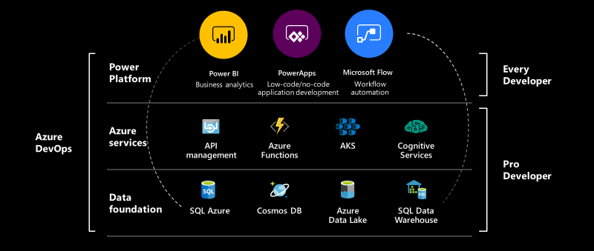
The bigger picture

Slide 12
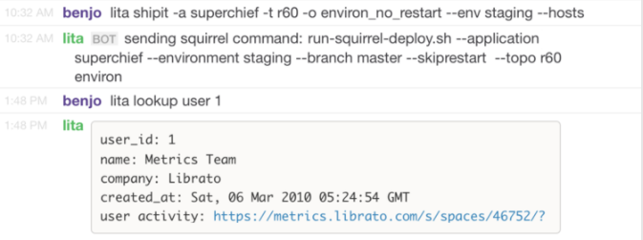
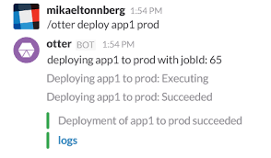
ChatOps over time
Notes:
https://blog.yellowant.com/advanced-chatops-with-microsoft-teams-part-1-1845acdc11a5

Slide 13
Microsoft teams as the ChatOps interface
Support for bots
Rich messaging capabilities
Identification and authentication capabilities
Mobile, web and desktop
Wide adoption
Notes:
For an advanced ChatOps implementation to succeed within a communication platform, there needs to be a couple of things in place:
Support for bots (check)
Rich messaging including Message Attachments, Fields, Buttons, Dropdowns and most importantly, Dialog inputs (check)
A robust and well documented API with publicly available wrappers and well defined auth scopes (check)
Mobile, Web and Desktop presence (check)
Public Channels and Private Groups (check)
The most important factor that determines if a ChatOps implementation will fail or succeed in an organization (and by succeed, I mean widely adopted and daily engaged with by users) is ease of interaction.
https://blog.yellowant.com/advanced-chatops-with-microsoft-teams-part-1-1845acdc11a5

Slide 14
Use Power Platform to empower your ChatOps
Interact in human language
Automate your processes
Get your data where you need it
Gain better insights
React to your environment

Slide 15
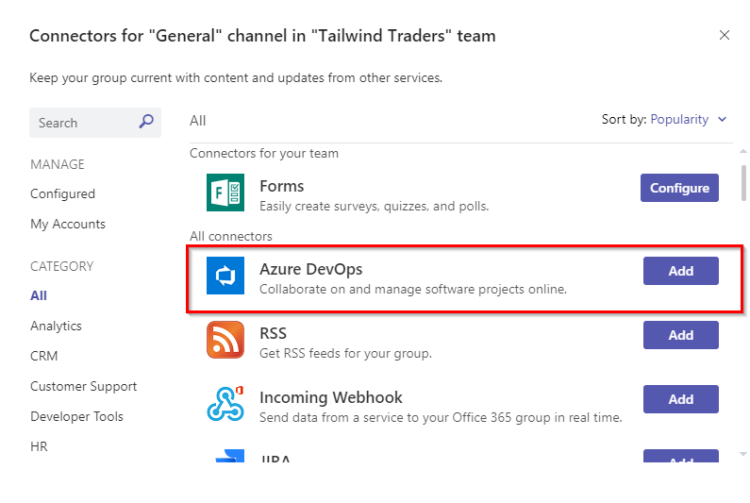
Why not use Teams plugins?
More process control
Can bring in other services
Use different tools together
Notes:
16

Slide 16

Task management
Notes:
15

Slide 17

Automate your tasks

Slide 18
How can ChatOps help
Pull requests approvals
Collaborative logging of conversations
Acknowledgement and assignment of issues
Automate Git setup
Notes:
https://chatbotslife.com/advanced-chatops-with-microsoft-teams-part-2-real-world-use-cases-d66dfbb3415a

Slide 19
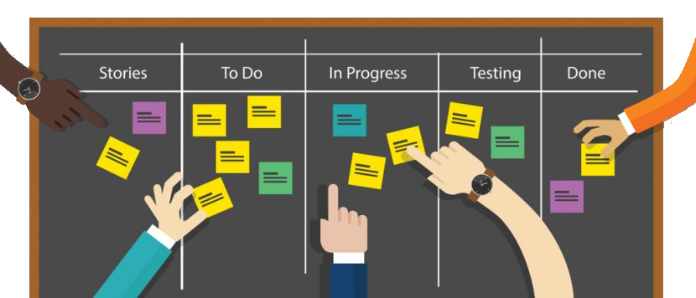
Demo
Task management
Notes:
18
Use PVA for user-initiated conversations in chat with bot
Fetch open tasks in Azure DevOps in chat with bot
Create new task in chat with bot
Show create task in Azure DevOps and click on link to branch for task in GitHub
Update README file create pull request
Notify when pull request created in Teams channel
Approve pull request
Show approved pull request
Power Virtual Agent - Implementing ChatOps using Microsoft Power Platform - Demo 1 - Retrieve my Azure DevOps tasks
Power Automate (open via PVA) - Implementing ChatOps using Microsoft Power Platform - Demo 1 - Retrieve my Azure DevOps tasks
Power Virtual Agent - Implementing ChatOps using Microsoft Power Platform - Demo 1 - Create Azure DevOps work item
Power Automate (open via PVA) - Implementing ChatOps using Microsoft Power Platform - Demo 1 - Create Azure DevOps work item

Slide 20

Selfservice resource deployment
Notes:
23

Slide 21
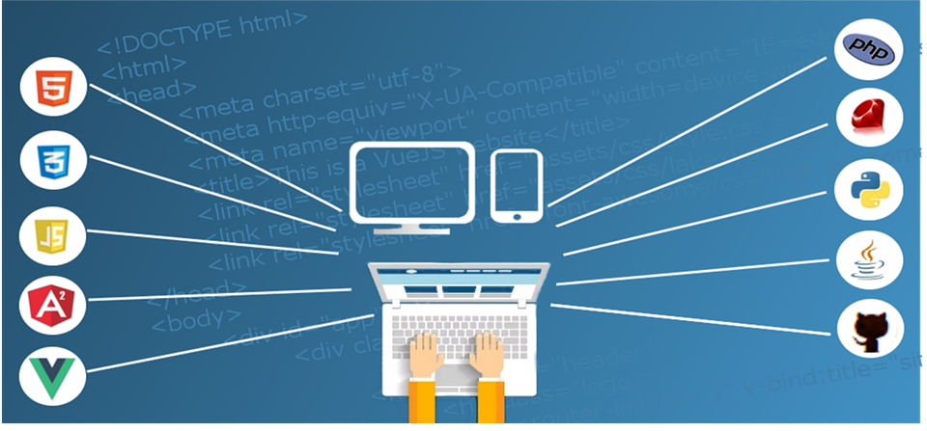
Empower your users

Slide 22
Advantages of using ChatOps
Quicker allocation of resources
Increased transparency around resource allocation
Place user in control while maintaining governance
Spend more time on important tasks
Notes:
https://chatbotslife.com/advanced-chatops-with-microsoft-teams-part-2-real-world-use-cases-d66dfbb3415a

Slide 23
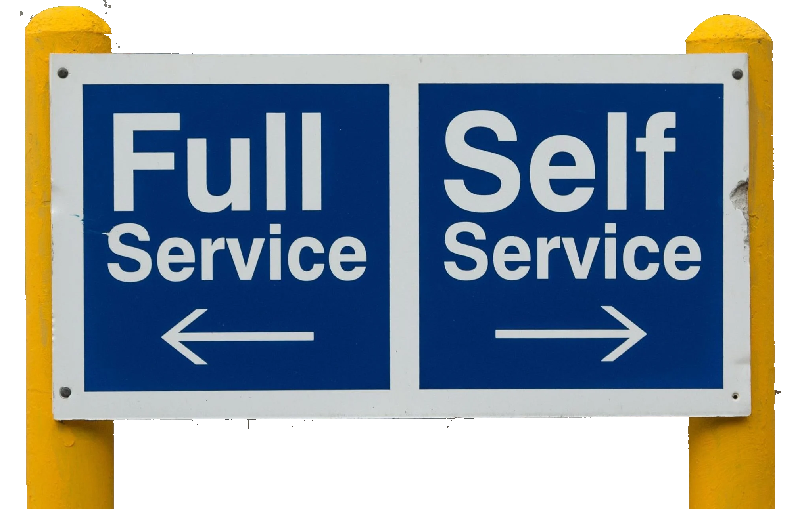
Demo
Selfservice resource deployment
Notes:
26
Team member asks for new resource via context menu
Show overview of possible resources (VM, Storage, Database, Web App)
Choose Storage Account
Ask input from team member for parameters
After choosing resource (storage) and inputs, ask manager for approval
After approval, deploy infrastructure
https://devblogs.microsoft.com/devops/announcing-general-availability-of-azure-pipelines-yaml-cd/?WT.mc_id=AZ-MVP-5002326
https://devkimchi.com/2020/03/05/implementing-chatops-on-github-actions/
https://chatbotslife.com/advanced-chatops-with-microsoft-teams-part-2-real-world-use-cases-d66dfbb3415a

Slide 24

Incident management
Notes:
31

Slide 25

Insights into an average incident

Slide 26
Speed up investigation and resolution
Faster acknowledgement of alarms and incidents
Rapidly bring together an incident team
Increased automation and control
Capture resolution data

Slide 27
Incident management lifecycle
Detection
Response
Remediation
Analysis
Readiness
Notes:
Monitoring, metrics, tresholds
Alerting, on-call, escalation
Fixes, tickets, deployment
Post mortem, how or why, understand
Improve, game days, learning

Slide 28
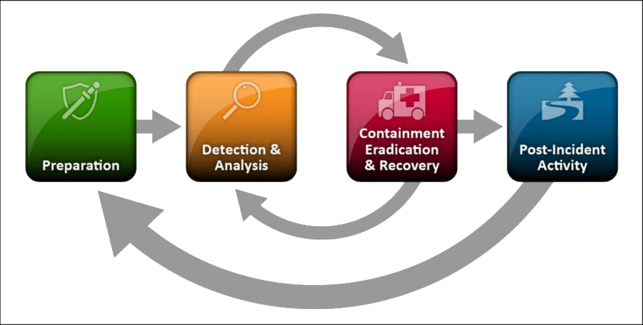
Demo
Incident Management
Notes:
34
Get alarm pushed from Azure in real-time as notification in Teams (trigger in VS Code)
Get alert in Teams
Decide on action with buttons
Create incident with title <conferencename>
Notify users that incident is in progress
Create war-room channel in Teams where discussion can happen
Send notifications to users on specific milestones and updates
Archive channel once resolved
Show incidents in Power Apps
Show Incident overview in Power BI
https://chatbotslife.com/advanced-chatops-with-microsoft-teams-part-2-real-world-use-cases-d66dfbb3415a

Slide 29

Almost done…
Notes:
39
Recap previous section

Slide 30
Recap
Powerful
Automate and empower with ChatOps
Extensible
Enables a wide range of scenarios
Easy
With Power Platform it’s a piece of cake to implement

Slide 31



Thank You!
@egrootenboer
eldert@eldert.net
https://www.linkedin.com/in/eldert-grootenboer

